Slide 1

LEADERSHIP
A leader is one who knows the way, goes the way and shows the way." —John C.

Slide 2

Name : Vijay Kumar
Section : T
Registration No. : 22BCON156
Subject : LS
Submitted To : Miss Avantika

Slide 3
Characteristics of an effective leader
A good leader takes responsibility for their leadership. They understand that everything they do directly affects the people they lead. In other words, the best leaders lead with their followers in mind. And one of the most important leadership traits is engaging your followers.

Slide 4

Vision:
Effective leaders have a clear and compelling vision of the future. They can articulate a direction that motivates and inspires their team.
Integrity:
Trust is crucial in leadership. Leaders with integrity are honest, ethical, and transparent, fostering trust and credibility among their team members.
Decisiveness:
Effective leaders make timely and well-informed decisions. They are not afraid to take calculated risks and are willing to course-correct when necessary.

Slide 5
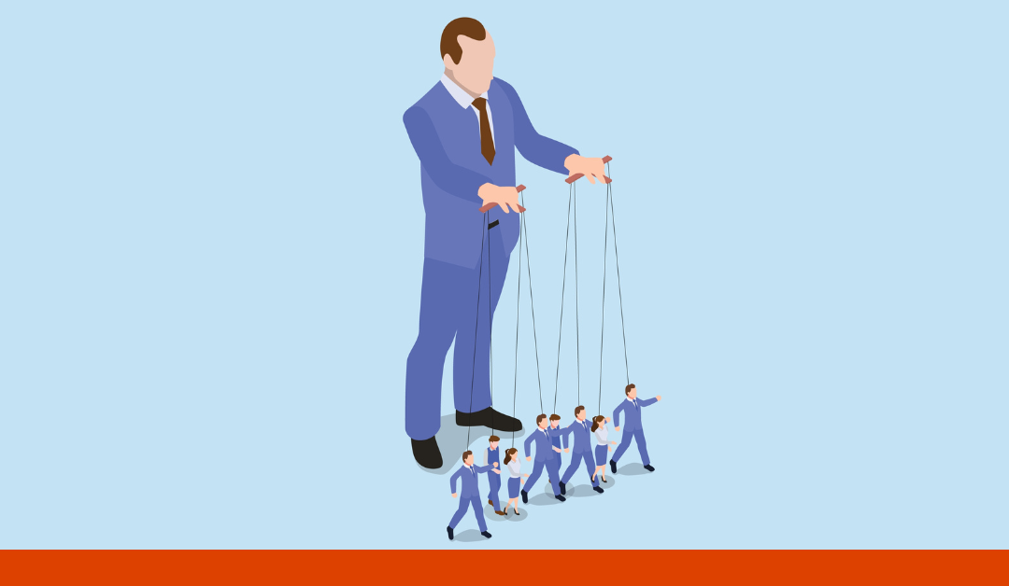
Various Styles of Leadership
Leadership styles refer to the approach and behaviors that a leader employs to guide and influence their team.
Autocratic Leadership:
In this style, the leader makes decisions without seeking input from others. It's a more directive approach where the leader has full control. While it can be efficient in certain situations, it may stifle creativity and motivation in the long run.

Slide 6
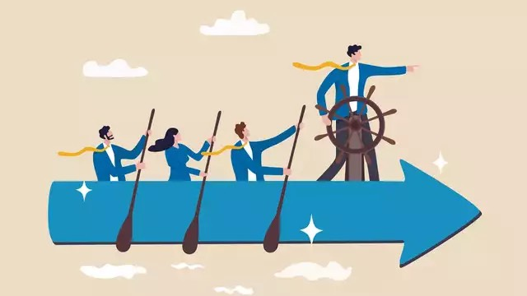
2. Democratic (Participative) Leadership:
Democratic leaders involve team members in the decision-making process. They seek input, feedback, and collaboration, promoting a sense of ownership and commitment among team members.
3. Bureaucratic Leadership:
Bureaucratic leaders follow rules and procedures closely. They ensure that tasks are carried out according to established protocols and policies.

Slide 7

4. Transactional Leadership:
Transactional leaders focus on the day-to-day operations and ensure that tasks are completed through rewards and consequences. They use a system of rewards and punishments to motivate and manage their team.

Slide 8
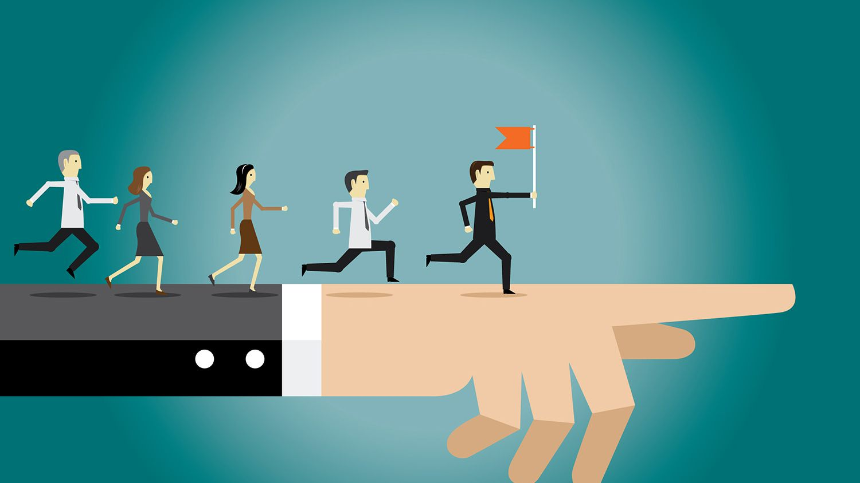
My Personal Leadership Style
My leadership style is democratic (participative) leadership. I always take opinions or suggestions of my team members and always try to do work in their favour and for the benefit of our team.

Slide 9
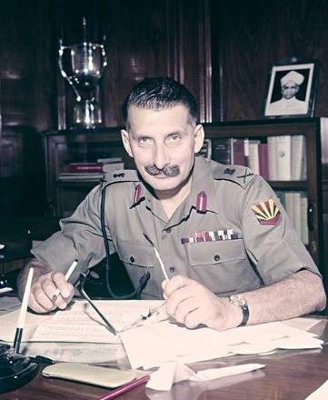
My Role Model
Dwight Eisenhower (1890-1969) – The 34th President of the U.S.
Corporal Sam Manekshaw
Field Marshal Sam Manekshaw, the first Indian Army officer to be promoted to the rank of Field Marshal, was a charismatic and highly respected military leader. He played a crucial role in India's military history, particularly during the 1971 Indo-Pak War that led to the creation of Bangladesh. Some of the leadership qualities that characterized Field Marshal Sam Manekshaw include:

Slide 10
“The greatest leader is not necessarily the one who does the greatest things. He is the one that gets the people to do the greatest things."
- Ronald Reagan
THANK YOU

